Slide 1
AI Driven Hotel Revenue Analysis Using Power BI
Predictive Analytics & Business Intelligence for the Hotel Industry
Vemuri Venkata Sathwik Kumar
Course: B.Tech CSE (AIML)
Tools: Power BI, DAX, Power Query
Dataset: Hotel Booking Dataset (2015–2020)

Slide 2






Project Overview
This project analyzes hotel booking data to generate revenue insights, customer behavior patterns, and predictive future trends using AI-driven analytics in Power BI.
Revenue Optimization
Customer Insights
Maximize hotel earnings.
Understand guest behavior.
Cancellation Analysis
AI Forecasting
Minimize revenue loss.
Predict future trends.

Slide 3

Business Problem
Hotels face significant challenges in managing revenue, high cancellation rates, and uncertain demand forecasting. Inefficient pricing and discount strategies further complicate operations.
Challenges
Solution
Revenue fluctuations
High cancellation rates
Uncertain demand
Inefficient pricing
Develop an AI-driven dashboard to analyze historical data and predict future revenue and demand trends.

Slide 4


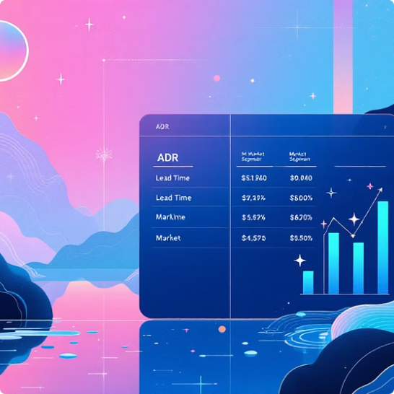
Dataset Description
The project utilizes the Kaggle Hotel Booking Dataset, covering over 100,000 bookings from 2015–2020. This comprehensive dataset provides crucial information for in-depth analysis.
Years Covered
Records
Key Features
100,000+ bookings
ADR, Lead Time, Market Segment, Customer Type, Cancellation Status, Meal & Discount Tables.
2015–2020
Data was appended year-wise into a Master Table.

Slide 5

Data Preprocessing & Feature Engineering
Rigorous data cleaning and feature engineering were performed to prepare the dataset for analysis, ensuring accuracy and enhancing predictive capabilities.
Data Appending
Merge sources and align records
Feature Creation
Data Cleaning
Handle nulls and fix datatypes
Engineer predictive features
Data Cleaning: Null handling, datatype fixes.
Data Appending: Multiple yearly datasets combined into a single Master Table.
Feature Creation: New columns like Arrival Date, Total Guests, Total Nights, Adjusted Revenue, and Lead Time Category.

Slide 6
Data Model & Measures
A Star Schema Model was implemented, featuring a central Master Table supported by key lookup tables. This structure facilitates efficient data retrieval and robust KPI tracking.
Star Schema
Key Measures
Main Table: Master Table
Supporting Tables: Meal Cost, Market Segment (Discounts)
Total Revenue
Revenue Loss
Cancellation Rate %
Revenue per Booking
Revenue Growth %
This enabled advanced KPI tracking for comprehensive insights.

Slide 7

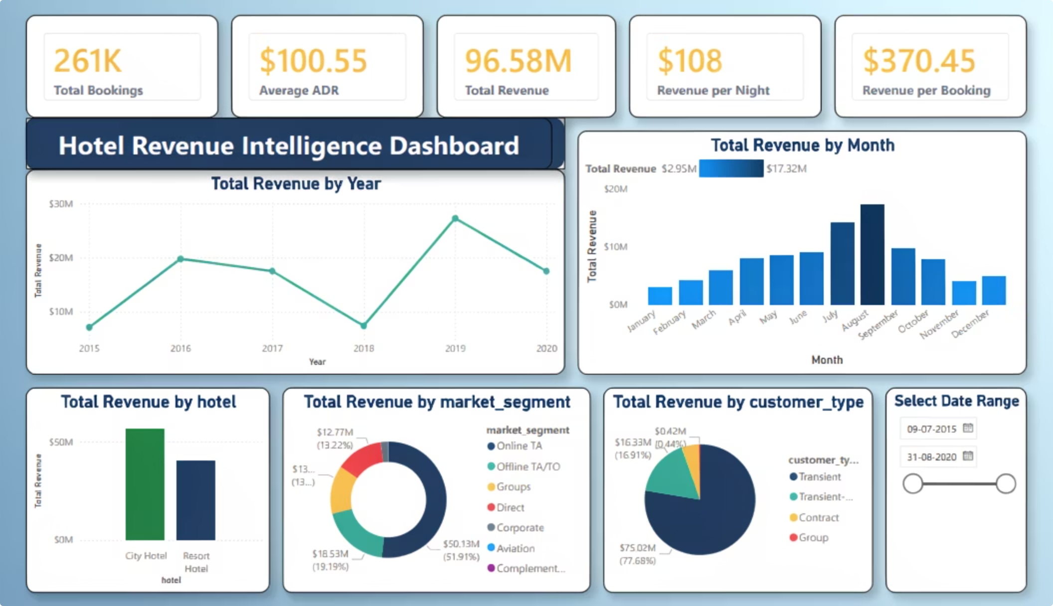
Dashboard 1: Revenue Intelligence
This dashboard provides a comprehensive view of revenue performance, including KPIs, trends, and seasonal analysis, with forecast-enabled insights.
Total Revenue KPIs
Revenue Trend
Market Segment
Seasonal Analysis
Key Insight: City hotels generated higher revenue during peak seasonal months.

Slide 8

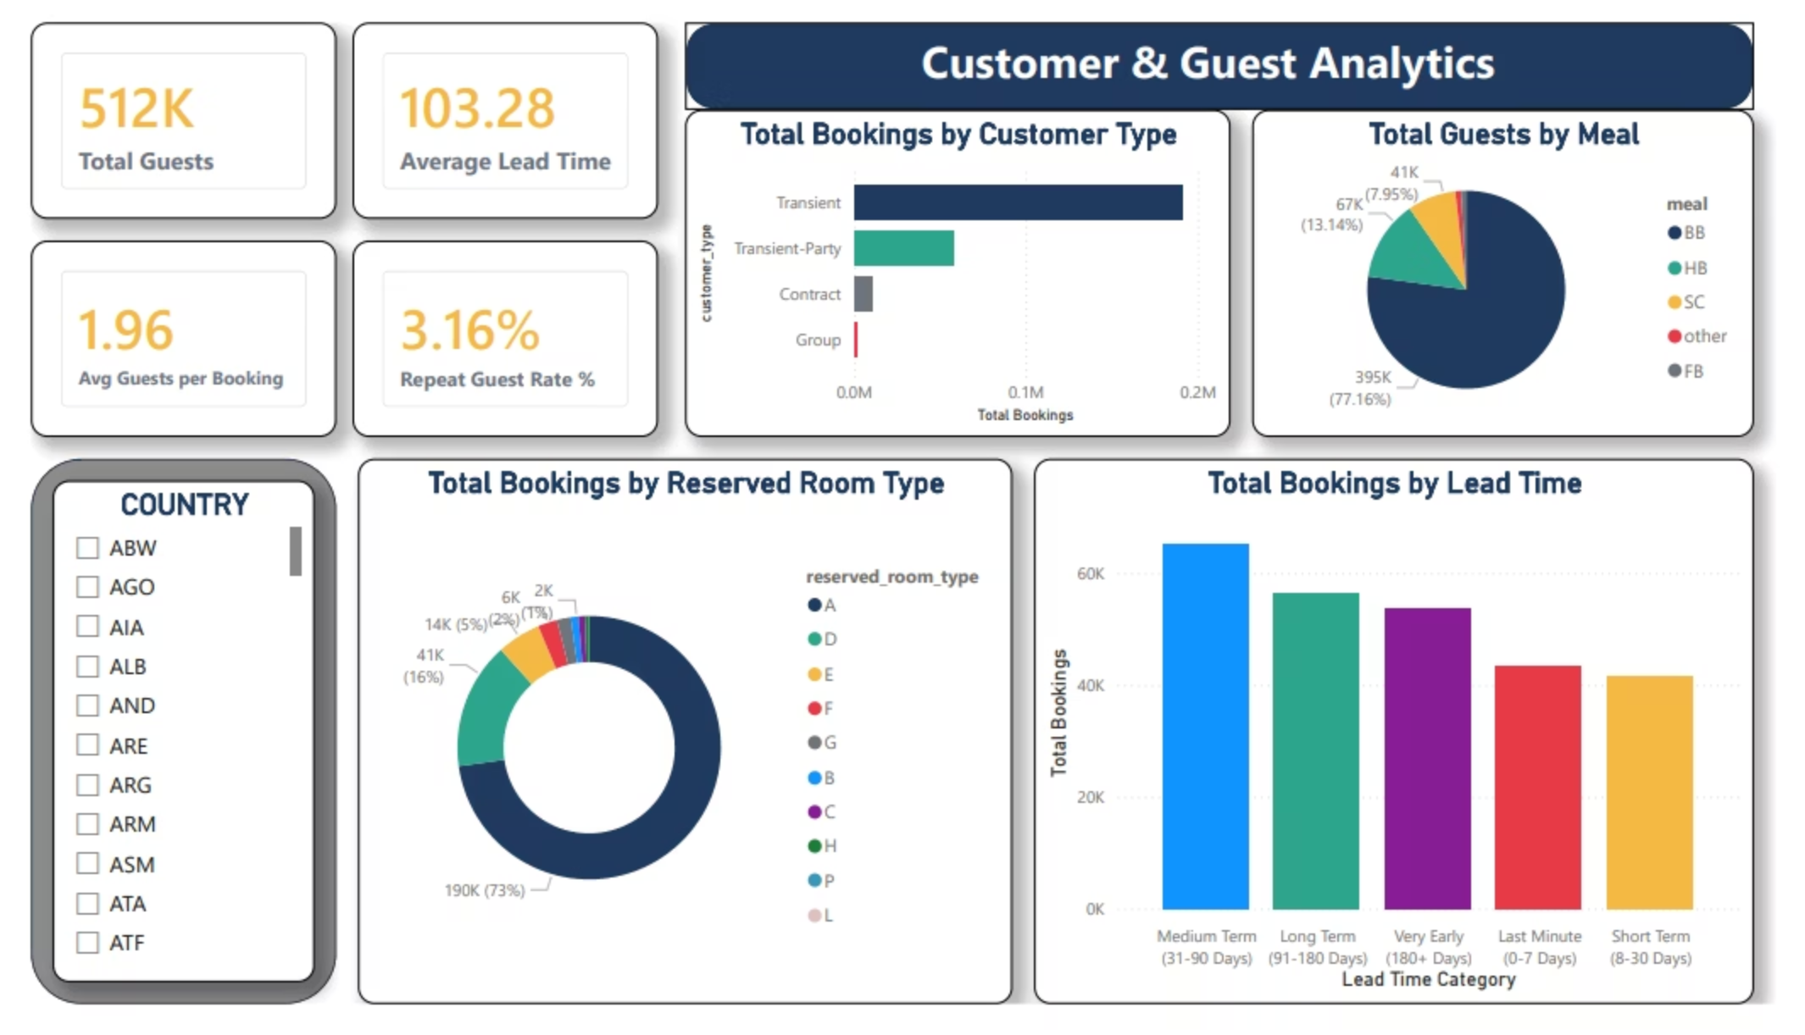
Dashboard 2: Customer & Risk Analytics
Customer Dashboard Includes:
Guest distribution by country
Lead time behavior analysis
Customer type segmentation
Booking demand trends

Slide 9

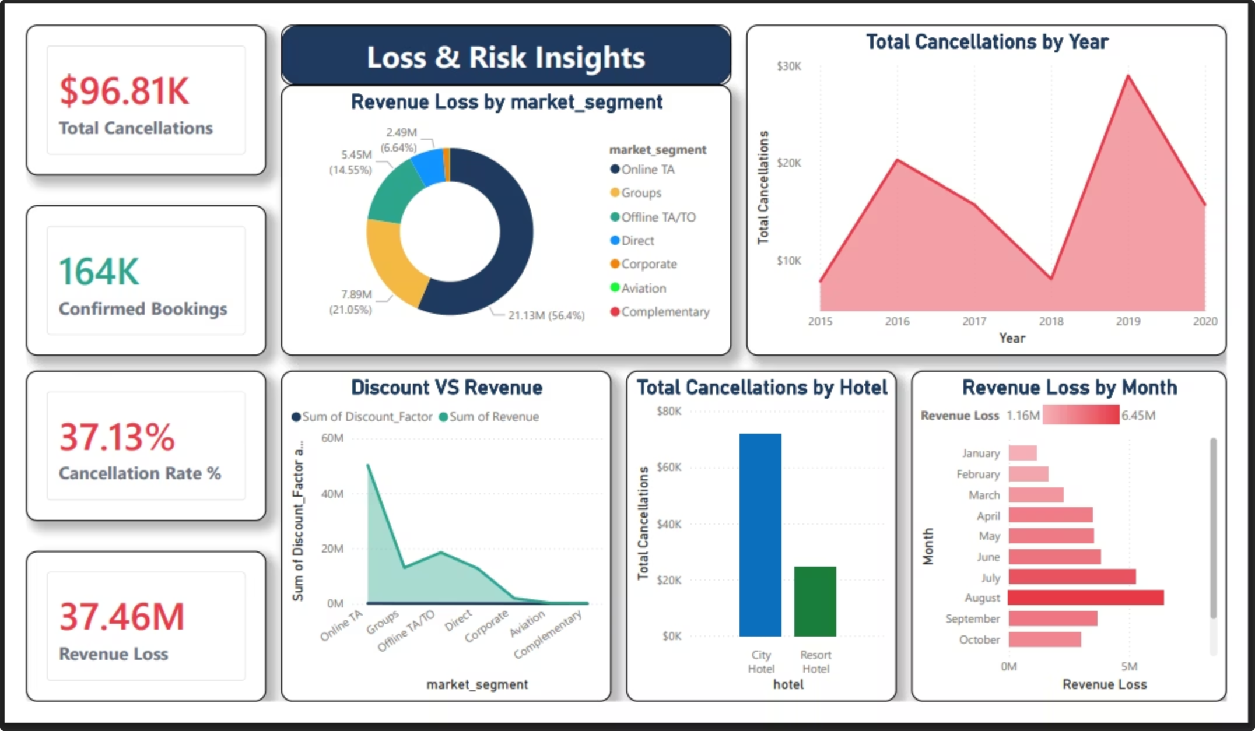
Dashboard 3: Customer & Risk Analytics
Loss & Risk Dashboard Includes:
Cancellation Rate %
Revenue Loss Analysis
Discount Impact on Revenue
Cancellation trend over time

Slide 10



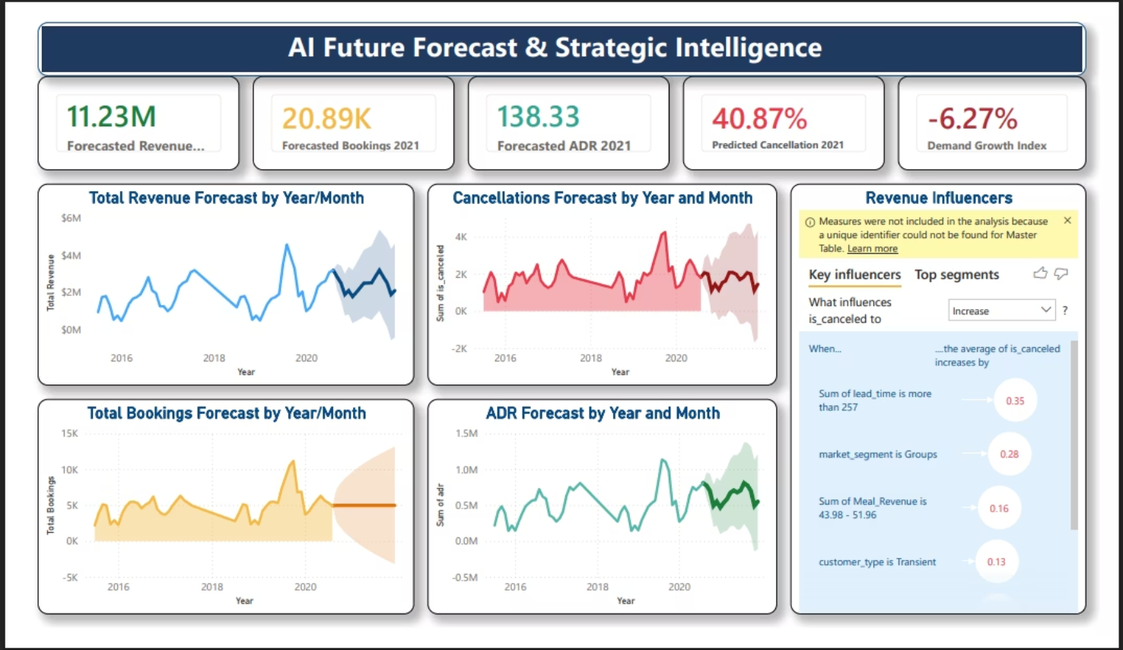

AI Driven Future Analysis
Core Innovation
Revenue Forecasting (Time Series)
Key Influencers (AI-driven insights)
Decomposition Tree (Driver analysis)
Demand trend prediction

Slide 11
Conclusion & Future Scope
Conclusion
Future Scope
AI-driven hotel analytics dashboard built.
Key revenue drivers and cancellation risks identified.
Predictive forecasting enabled via Power BI AI visuals.
Improved business decision support.
Real-time hotel data integration.
Machine Learning prediction models.
Dynamic pricing optimization.
Automated AI recommendation system.
View the file through here :
https://app.powerbi.com/groups/me/reports/373a65eb-259a-4eb0-81a1-4504e2753c43?ctid=9206f595-4edd-4d55-b874-c330b03c51d7&pbi_source=linkShare

